Slide 1


INTERNET OF MEDICAL THINGS
SECURE IOMT GATEWAY FOR INDOOR ENVIRONMENT QUALITY MONITORING SYSTEM IN EEG LAB
MEMBERS OF GROUP:
Nguyen Thi Diem Anh - 20213653
Ngo Thuy Duong - 20213659
Tran Mai Linh - 20213675
Zajmena Hasa - 2024T0041
INSTRUCTOR:
Dr. Dao Viet Hung
Dr. Pham Phuc Ngoc

Slide 2
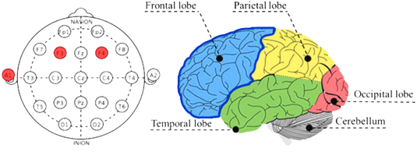
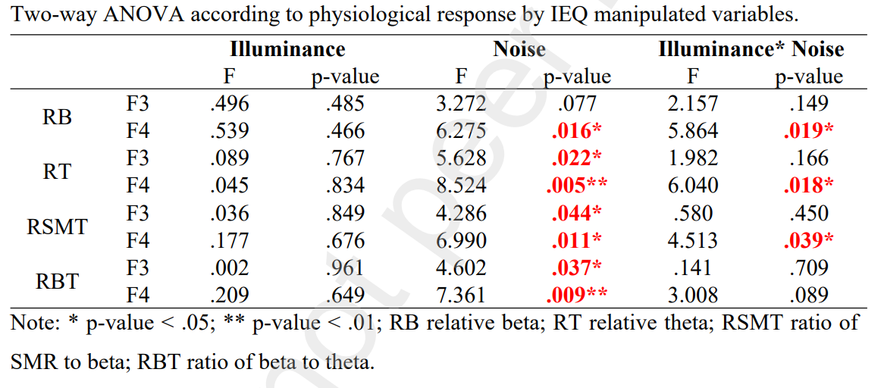
Problem
Statement
A recent study has shown that indoor environmental factors like light, temperature, humidity, and air quality can impact brainwave activity, affecting the accuracy of EEG measurements. To improve precision in EEG experiments, we want to develope an IoT device that continuously monitors and adjusts these environmental factors in real-time to ensure that EEG measurements more accurately reflect true changes in brain activity. This system may face challenges when malicious people want to sent unauthorized data or attack DoS.
2
2

Slide 3
Problem Statement
Objective
Expected Outcomes
The project aims to design and implement a secure gateway for an Indoor Environment Quality Monitoring System to ensure secure, real-time monitoring of key environmental parameters in the EEG lab for optimal working conditions.
.
Real-Time Monitoring
Data Logging and Storage
Health & Comfort of Lab Occupants
3

Slide 4
Problem Statement
4
Standard Environmental Factors in EEG Laboratory
Factors | Acceptable Range | Effect
Temperature | 20- 25℃ | Ensure comfort for participants and stable electrode contact.
Humidity | 30 - 60% RH | Prevent excessive sweating (high humidity) or dry skin (low humidity)
Noise | <35dB | Low levels of noise are essential, as even background noise can disrupt EEG readings
Illumination | 300-500 Lux | Soft, indirect lighting to avoid glare or excessive brightness that may affect EEG data
CO2 concentration | <1000 ppm | High levels of CO₂ can affect cognitive performance and brainwave patterns
CO concentration | <10 ppm | High levels of CO can impair cognitive function and lead to health risks, which can affect EEG results

Slide 5
Requirements
Functional
Nonfunctional
Environmental Monitoring
monitor various environmental factors such as temperature, humidity, CO2 concentration, CO concentration, lighting, noise level within the EEG laboratory.
Data Integrity and Accuracy
The system must ensure the accuracy and integrity of the environmental data, ensuring that sensors and other devices are calibrated and maintained to provide reliable information
Real-time Data Collection
The system must collect data from connected sensors and provide real-time readings to the user interface.
Scalability
The system must be scalable to accommodate additional sensors or monitoring devices without affecting performance.
Data Logging and Storage
The system must store all environmental data over time, allowing for historical data retrieval and analysis.
Security
Ensure the security of environmental and EEG data by using encryption protocols during transmission and secure storage.
Integration with EEG System
The environmental monitoring system must integrate with the EEG system, ensuring that environmental data can be factored into EEG analysis for improved accuracy
Usability
The system must have an intuitive, user-friendly interface so that laboratory personnel can easily configure settings, view data, and analyze results without specialized training
5

Slide 6

Scenario
Step 1: Planning and Installation
Sensor Placement
50cm
50cm
Temperature and humidity sensors are installed near EEG recording stations to capture localized data.
Air quality sensors are placed near ventilation systems and patient areas.
Noise and light sensors are distributed across the lab, focusing on potential disturbance sources.
50cm
50cm
Figure 1: Placement of Iomt nodes
System Integration
Sensors are calibrated and connected to the IoMT gateway.
The gateway is configured to transmit data securely to the server.
6

Slide 7
Scenario
Step 2: Monitoring
Sensors collect data only when pressing the button during the experiment
The IoMT gateway collects data and updates the cloud platform every few seconds
Step 3: Data Analysis and Visualization
The cloud platform processes data and applies machine learning algorithms to detect anomalies.
The analytics dashboard displays:
Current Conditions: Temperature: 23°C, Humidity: 50%, Noise: 35 dB, CO2: 400 ppm, Light: 300 lux.
Trends and Predictions: Highlights potential deviations based on historical data.
7

Slide 8
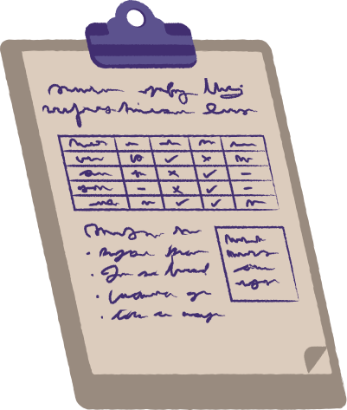
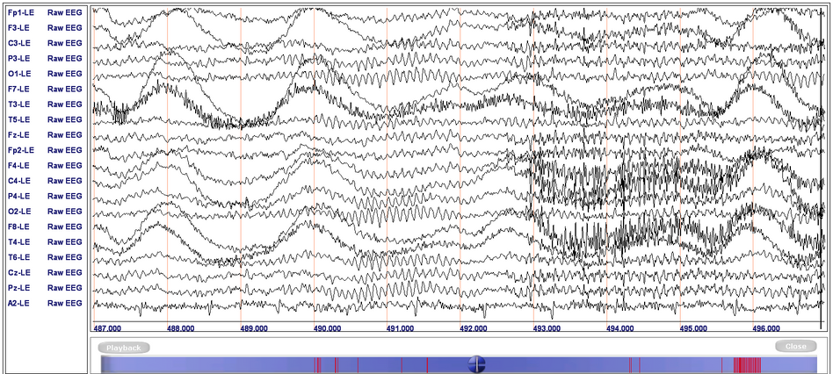
Scenario
Step 5: Integration with EEG Data
Environmental data is timestamped and synchronized with EEG recordings.
Analysts can correlate EEG signal anomalies with environmental changes
A report of parameters will be exported
+
8

Slide 9

Noise sources
Respiration and Cardiac Activity
The heartbeat (ECG artifacts) or breathing can cause low-frequency fluctuations in the EEG signa
Power Line Interference
Poor grounding, proximity to power lines,
or faulty wiring
NOISE
SOURCES
Sweating or Skin Conductance
Changes in skin conductivity can affect the impedance of EEG electrodes
Equipment Noise
Fluorescent lights can generate
high-frequency noise
Muscle Artifacts
Movements such as blinking, chewing, or jaw clenching generate electrical activity that overlaps with EEG signals
Cabling Issues
Cross-talk between cables or improper shielding of EEG leads
Acoustic Noise
Sound from adjacent rooms, corridors, or external sources like traffic
9

Slide 10
Methods
5
Feature | MQTT | HTTP | CoAP
Communication Model | Publish/Subscribe | Request/Response | Request/Response
Transport Protocol | TCP | TCP | UDP
Efficiency | Moderate | High | Low
Power Consumption | Moderate | High | Low
Reliability | High (QoS levels 0, 1, 2) | Reliable but no QoS | Lightweight reliability (ACKs)
Security | TLS/SSL | HTTPS | DTLS
Bandwidth Efficiency | High (minimal overhead, efficient for small messages) | Low (high overhead, inefficient for small messages) | Very High (minimal overhead, optimized for low bandwidth)
Choose MQTT for indoor environmental monitoring in an EEG lab as the system needs to continuously track multiple parameters (temperature, humidity,...) and ensure reliable, low-bandwidth communication
10

Slide 11
Methods
6
Criteria | Bluetooth | Wi-fi | USB cable
Range | Medium (~10m) -> suitable for lab environment | Large (~30m) | Short
Data Rate | Medium (~1 Mbps) | High (~100Mbps) | High
Stability | Good, low interference in short range | Depends on Wi-fi netwofk quality | Very stable
Cost | Low | Medium | Very low
Power Consumption | Low | Higher | Negligible
Scalability | Medium (optimal for 1-to-1 or few devices) | High (supports many devices over network) | Low (1-to-1, difficult to scale)
Conclusion | Suitable (compact, flexible, stable) | Good (but overkill for small range) | More cumbersome
11

Slide 12
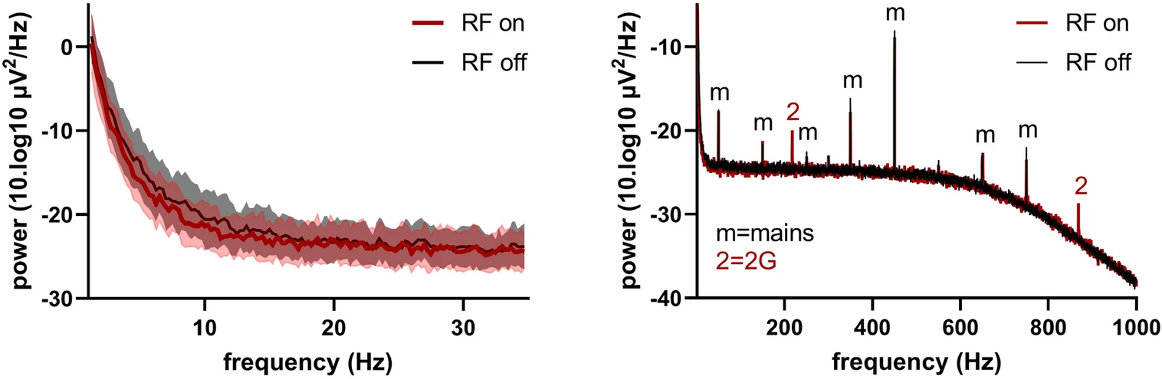


Effect of Bluetooth on EEG
Operating frequency: 2.4 GHz
Transmission power: 2.5mW, relatively small
Figure 2: PSD plots of voluteer EEG measurement with Bluetooth on and Bluetooth off
left: PSD plot in range 0–35 Hz, no differences visible in the physiological range of the signal
right: PSD plot in range 0–1000 Hz, 50 Hz and 217 Hz and higher harmonics present in RF on
Bluetooth waves can interfere with EEG signals, but this effect is very small, almost does not affect the brain's operating frequency, but it is still necessary to ensure that the measuring device meets EMC standards (IEC 60601-1-2) and has a suitable high-frequency filter
12

Slide 13
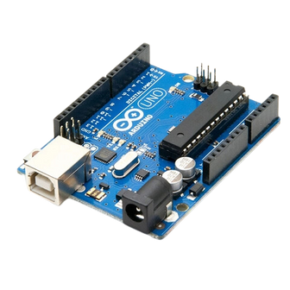
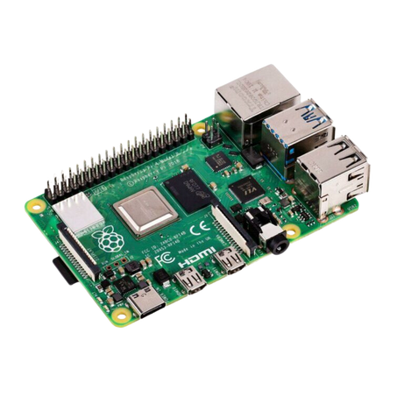



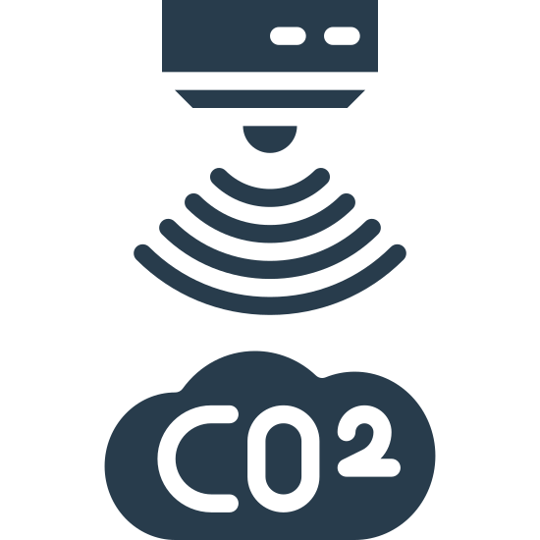
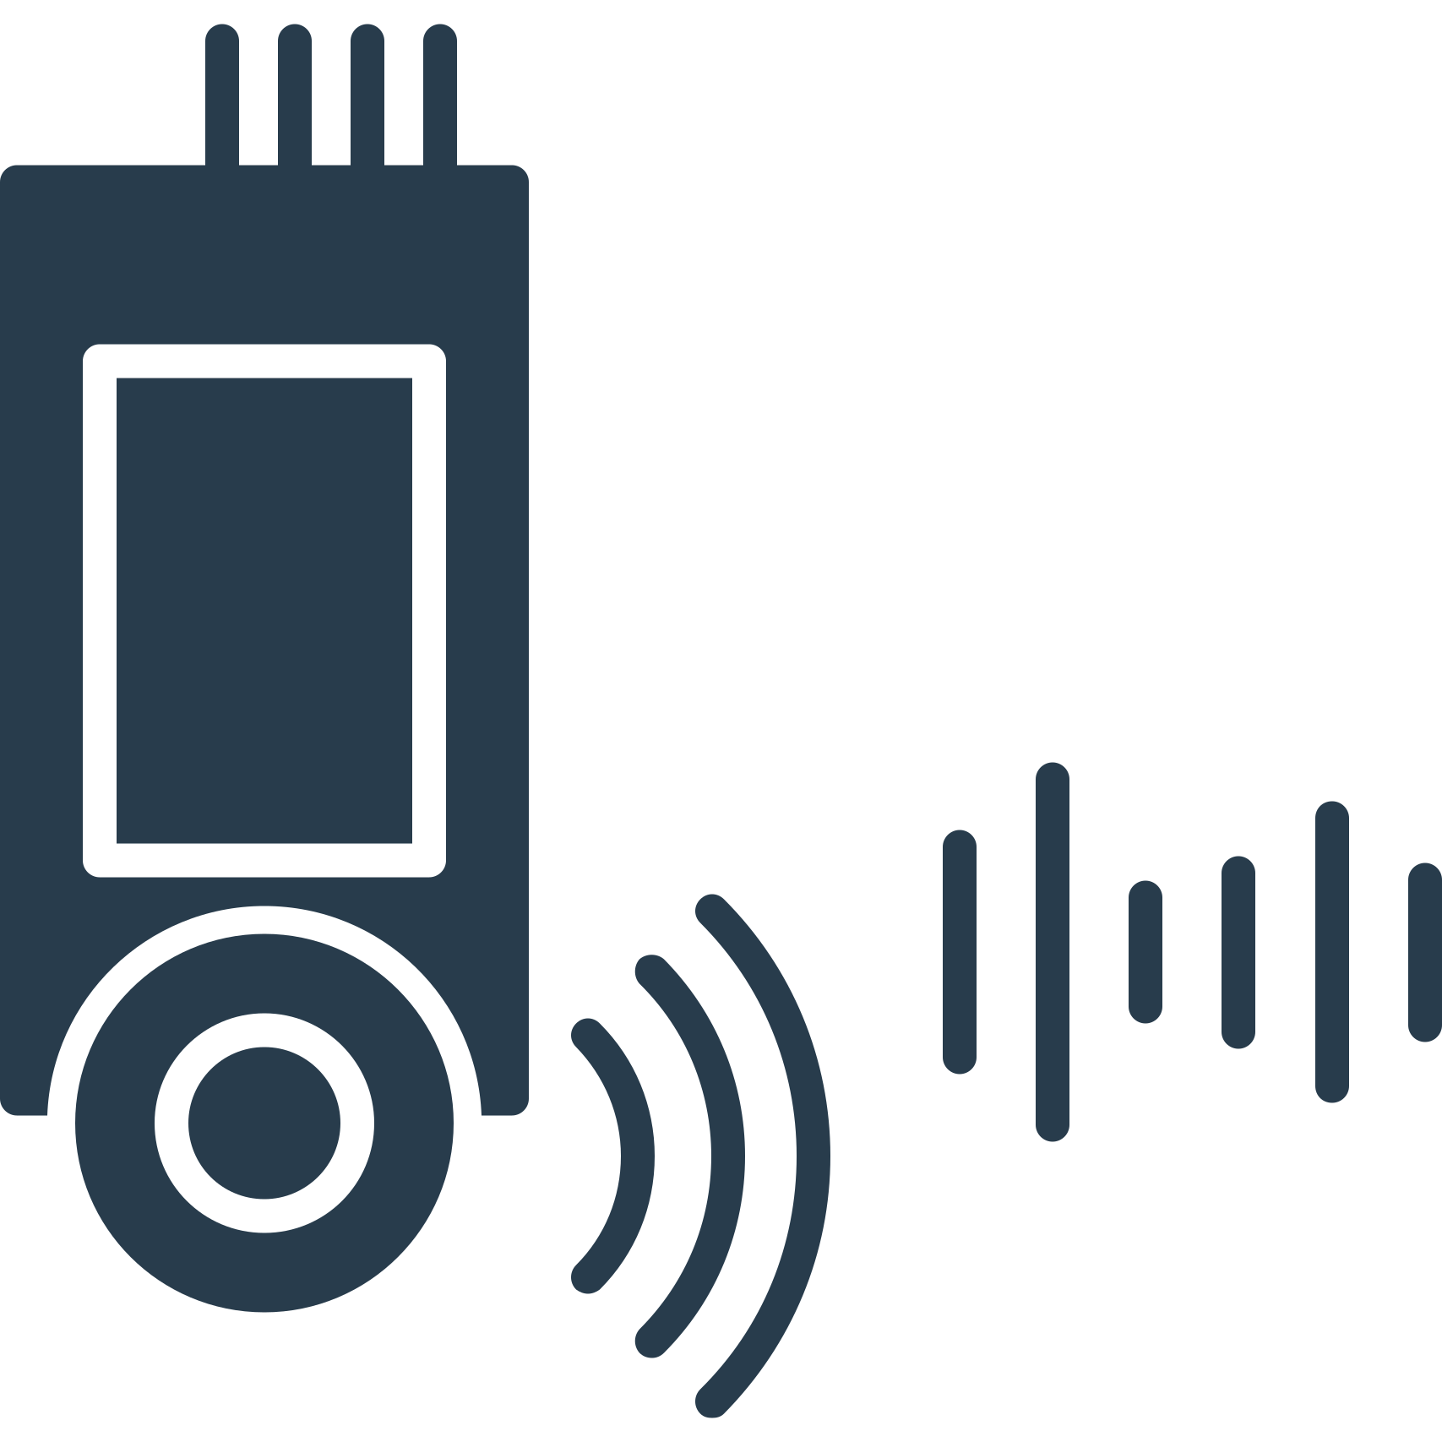

Methods: Block Diagram
Bluetooth
MQTT
Microcontroller
(Arduino Uno)
Gateway
(Raspberry Pi 4 Model B)
Server
MQTT
Temperature & Humidity Sensor
Gas
Sensor
Noise
Sensor
Light
Sensor
User s’ laptop, mobile
13

Slide 14
Methods: Flow Chart
Start
Sensors collect data from the environment as voltage signals
Raspberry Pi checks and transmits data to Server by MQTT
Signals are processed by Arduino and sent to Raspberry Pi via Bluetooth
Server decrypts data
Displaying real-time environmental information, allows users to access and view data statistics.
Server storages and analyzes data, provides a interface to the users
Raspberry Pi encrypts data
End
14

Slide 15
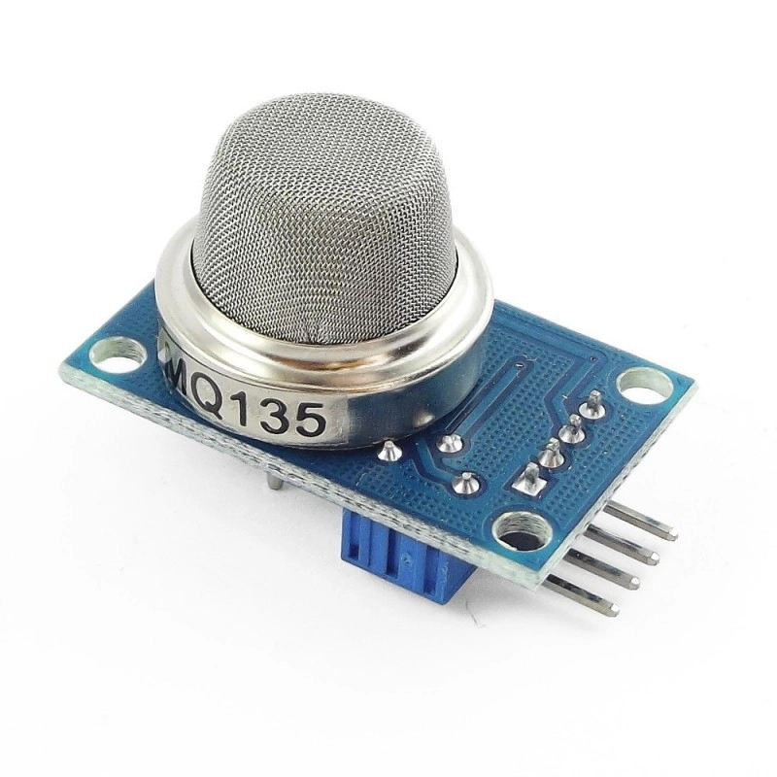
Detailed Design
Sensors
Features
Wide Detection Range:
Detects a variety of gases, making it versatile for general indoor air quality monitoring.
Sensitive to gases like ammonia, CO₂, benzene, and smoke.
Voltage and Current Requirements:
Operates at 5V, suitable for integration with microcontrollers like Arduino and Raspberry Pi.
Low power consumption, making it efficient for continuous monitoring.
Analog and Digital Outputs:
Provides both analog and digital signals for flexible use.
Analog output allows for more precise gas concentration measurement.
Cost-Effective:
Affordable compared to specialized air quality sensors.
CO, CO2 concentration
Figure 3 : MQ-135 sensor
15

Slide 16
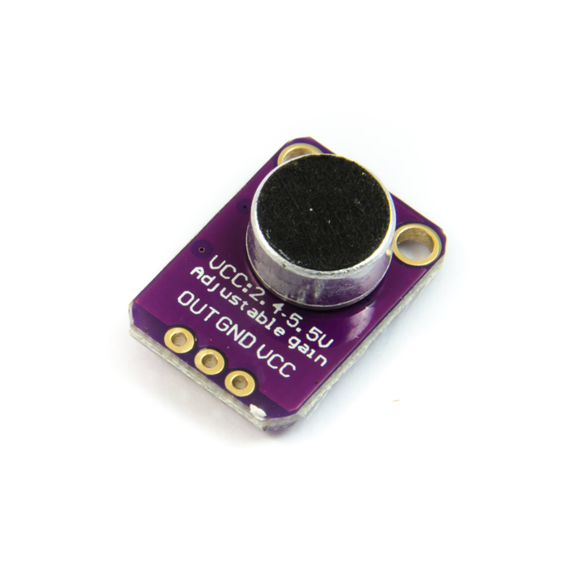
Detailed Design
Sensors
Features
Wide Detection Range: Operates effectively across a broad input voltage range, ideal for diverse applications like voltage monitoring and signal detection.
Low Voltage & Current Requirements: 2.4V to 5.5V, perfect for battery-powered systems.
Analog & Digital Outputs: Offers flexible outputs for interfacing with both analog and digital circuits or microcontrollers.
Cost-Effective: Affordable yet reliable, making it suitable for commercial, industrial, and hobbyist projects.
Sound detection
Figure 4 : MAX4466 sensor
16

Slide 17
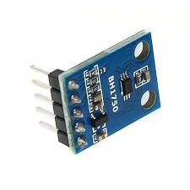
Detailed Design
Sensors
Features
Wide Detection Range: Measures ambient light from 1 lux to 65,535 lux, suitable for low-light indoor to bright outdoor conditions.
Voltage and Current Requirements: Operates at 2.4V–3.6V with low power consumption, ideal for battery-powered and IoT devices.
Digital Output: Provides precise measurements via an I²C interface, simplifying integration with microcontrollers without the need for ADCs.
Cost-Effective: Offers reliable performance at an affordable price, reducing implementation costs for a wide range of applications.
Light intensity
Figure 5 : BH1750 sensor
17

Slide 18
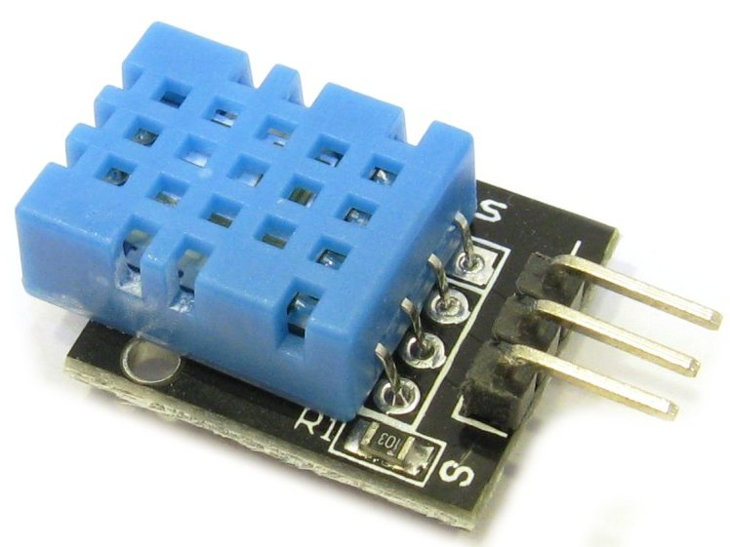
Detailed Design
Sensors
Features
Wide Detection Range: Measures temperature from 0°C to 50°C (±2°C accuracy) and humidity from 20% to 90% RH (±5% accuracy).
Low Power Requirements: Operates on 3.3V–5V, consuming only ~2.5 mA during use and ~100 µA in standby mode.
Digital Output: Provides a simple single-wire digital signal, eliminating the need for an external ADC.
Cost-Effective: Affordable and reliable, ideal for budget projects and basic environmental monitoring.
Temperature & Humidity
Figure 6 : DHT11 sensor
18

Slide 19
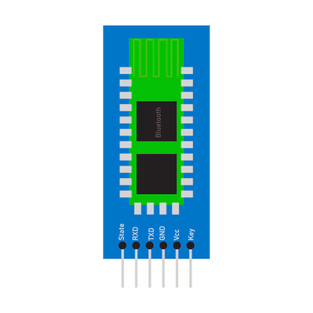
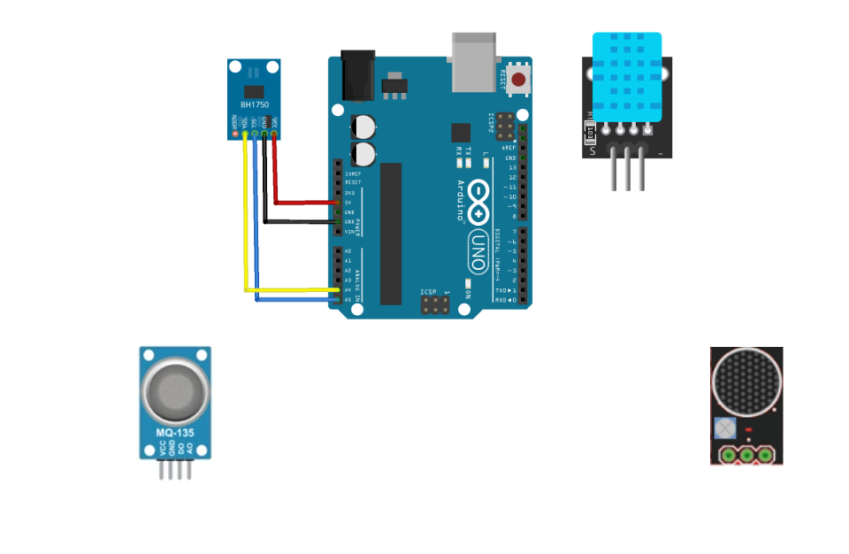
Detailed Design
IoMT node wire connection
Our IoT node contains Arduino, HC-05, MAX4466, MQ-135, DHT 11 and BH1750:
Pin A0 of MQ-135 connects to A0 of arduino
Pinout of DHT11 to D7 of arduino
Pin SCL, SDA of BH1750 to A4, A5 of arduino
Pinout of MAX4466 to A2 of arduino
Pin TX, RX of HC-05 to 10,11 of Arduino
Figure 7: IoMT node connection
19

Slide 20
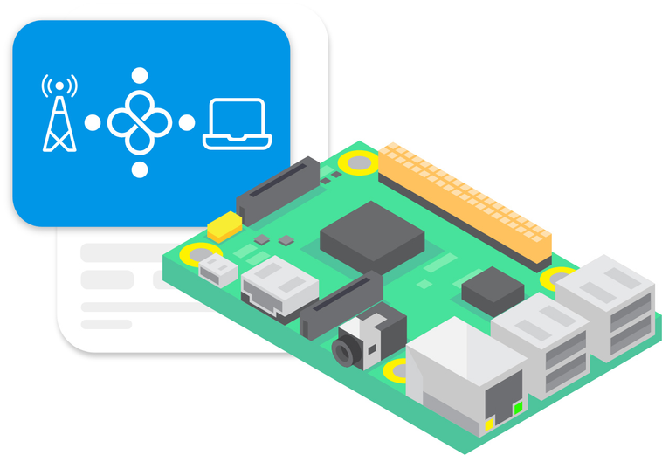
Detailed Design
IoMT gateway data acquisition
IoMT node
Bluetooth
Publish JSON Data
IoMT gateway
CO2 Concentration, light intensity, sound level, temperature, humidity are delivered chronologically and packed to a JSON string, each string is sent to the IoMT gateway every 1 second.
20

Slide 21


Network Layer
Tailscale net
A VPN solution based on WireGuard.
Simplifies the creation of secure private networks. Enables encrypted connections between devices, even behind NAT or firewalls.
Remote Access
Safely access IoT devices remotely without port forwarding.
Zero Trust Network
Only authenticated devices can join.
Reduces risk of intrusion.
Easy Deployment
Compatible with Linux, Raspberry Pi, Android, Windows, etc.
SSH session
Laptop
Server
Gateway
SSH session
SSH session
Figure 8: Tailscale VPN mesh
21

Slide 22
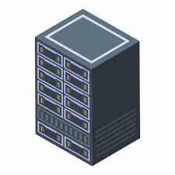
Network Layer
MQTT client
MQTT broker
MQTT
Publish JSON Data
IoMT gateway
Server
Risk of Malicious Publishers
Malicious Publishers can send harmful messages.
Subscribers may receive unauthorized or harmful content.
Need an encryption solution
22

Slide 23
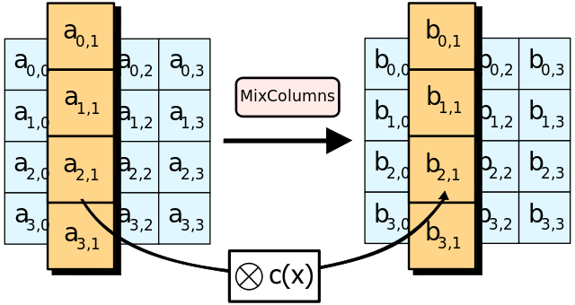
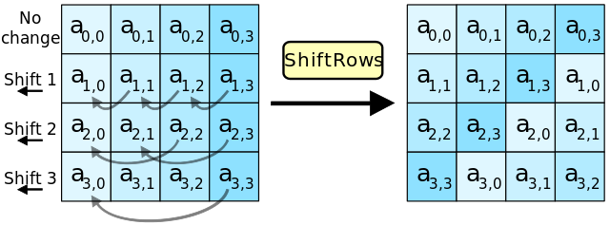
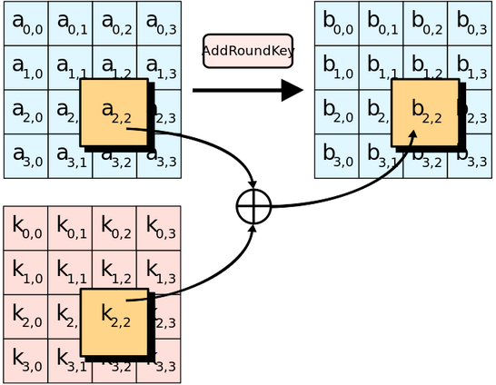
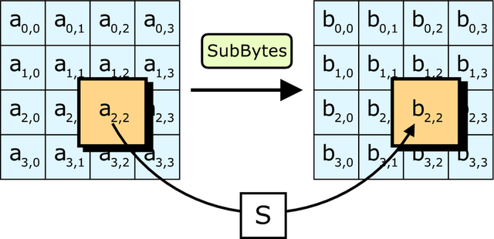
Encrypt process
SubBytes step
Each byte is replaced by a byte according to the lookup table, S; bij = S(aij).
ShiftRows step
Bytes in each row are shifted left circularly. The number of shifted positions depends on the row.
AddRoundKey
Each byte is combined with a byte in the round’s subkey using the XOR () operation.
MixColumns step
Each column is multiplied by a fixed factor c(x).
23

Slide 24
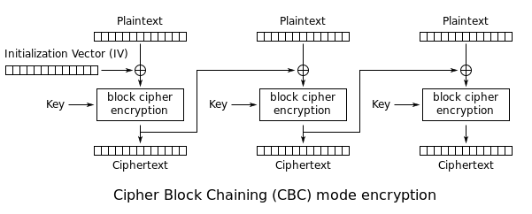
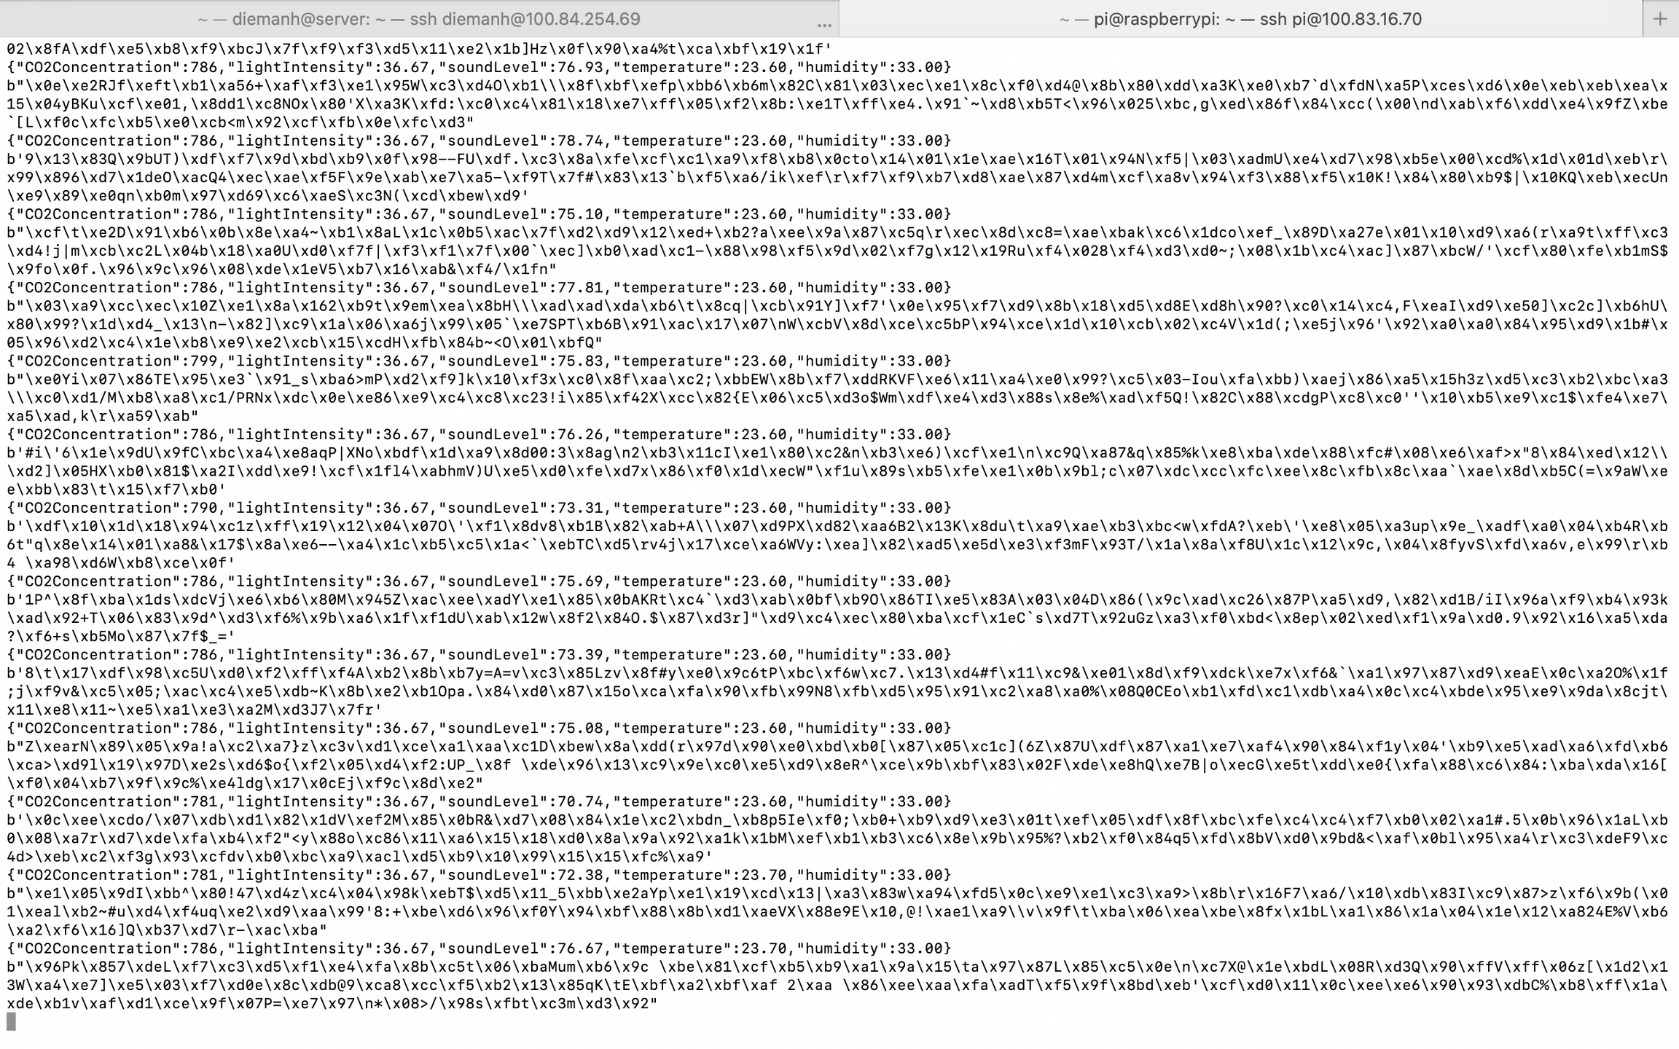
Encrypt & decrypt data
AES-256-CBC
AES (Advanced Encryption Standard) is a “block cipher” algorithm. AES has become one of the most popular encryption algorithms that uses symmetric keys for encryption and decryption
Data from Arduino is then encrypted by AES-256-CBC
24

Slide 25
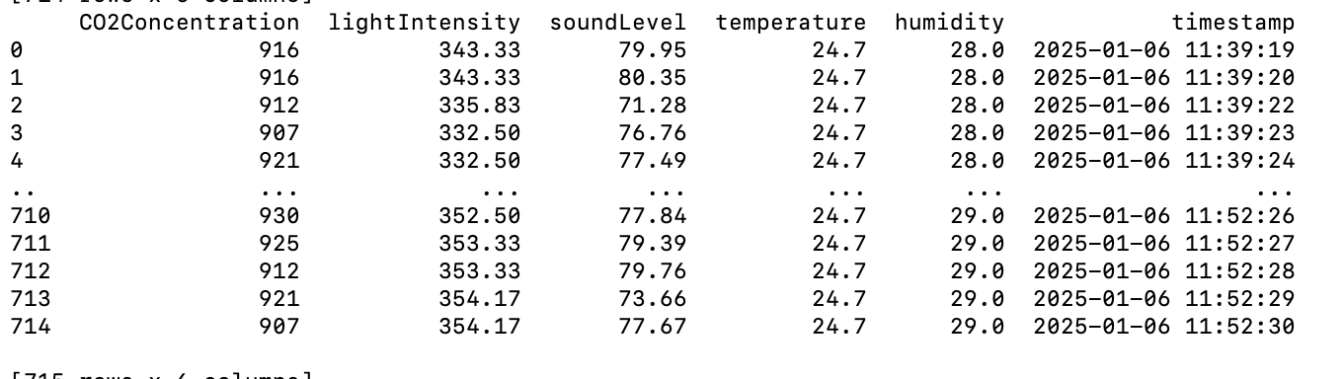
Encrypt & decrypt data
AES-256-CBC
Encrypted data is sent to the server by MQTT, decrypted and saved to table envData.tsv for storage, the table has 6 columns: CO2 Concentration, lightIntensity, soundLevel, temperature, humidity, timestamp
Figure 9: Data on server
25

Slide 26
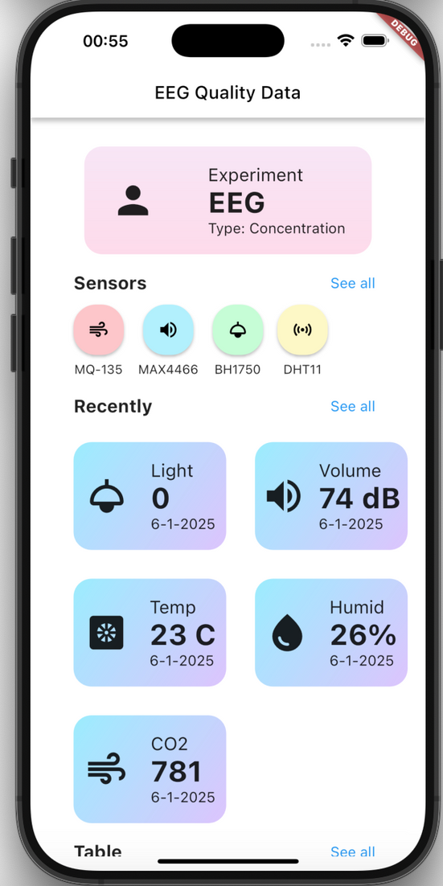
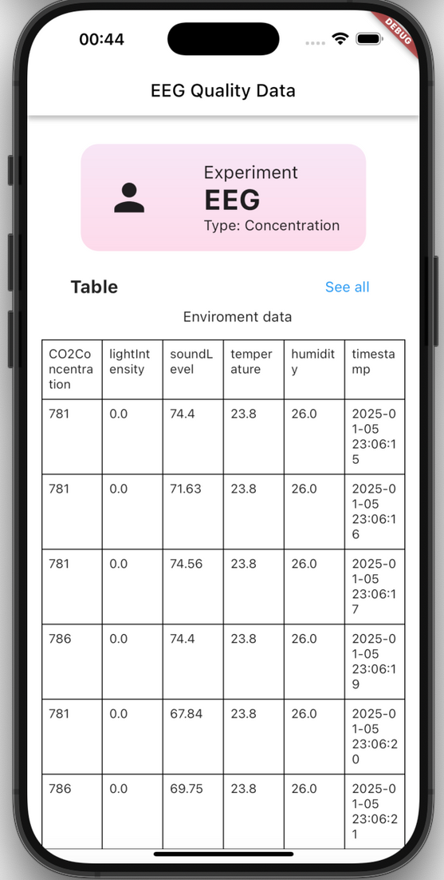
Application Layer
Data in the storage will be displayed in a flutter app for monitoring environment parameters
Figure 10: EEG Quality Data app screens
26

Slide 27
Conclusions
Results
We have designed an IoMT gateway with security purpose by applying AES-2565-CBC
We implemented an IoMT node to test the data sent to the gateway and server to store data. A flutter app is applied to display the results from environment data
Challenges
The node modules are affected by the loosely wire
If the module is impacted, the first bit of data sent from arduino is incorrect format, which cause the lost of data
We haven’t check other scenarios, as the hacker sends the data with another topic may the server verify the authority of the data
27

Slide 28



THANK
YOU!

